Slide 1
College erp system
Present at : lokmanya college of computer application

Slide 2
Project Profile
Presented by :
SHARMA SHAILESH MUKESH BHAI MANOJ GUPTA
UTTAM KUMAR SINGH
Internal guide :
karishma rao
external guide :
yash soni

Slide 3
Company Profile
Company Name | Prakshal IT academy
Company Website | www.prakshal.com
External Guide | Yash soni
Company Address | 2’nd floor,om towes, Opp star bazar ,nr jodhpur cross road,Ahmedabad 380015
Contact No | 7228953264

Slide 4
Presentation flow
Objectives
Existing system
Need for new system
System module
Features of system
Diagrammes
flowchart
DFD evel – 0
DFD level -1
DFD level -2
ER diagramme
Data disctionary
Project application
Future enhancement
conclution

Slide 5
Objective
This System can manage the collage data. Which is managed by admin or principle.
This System provide online data validation for student.
student can ask any question to the faculty and faculty can answer that question.
Principle or admin can give notification all of the student and faculty
Student can share there experience about their collage.
7. Student can submit their assignment .

Slide 6
Existing System
Data can not be stored.
Can not be view student performance.
Student’s progress can not be detect .
Danger to losing important files in some cases.
Certain required report is not available.
Current system is not user friendly .

Slide 7
Need for new System
It is a online web based system.
Easy to use and user friendly system.
Easy to generate payroll.
Easy to upload daily work progress .
Student can ask a many question to faculty.
Student can give their feedback to collage environment.

Slide 8
system module
Admin
Add student ,faculty
Generate cirquellar
Show que and ans
Show profile
Student
To Asking question
To submit Assignment
To Get Notification
To modified profile
Faculty
Add student
Give and check assignment
Get notification
Answer the question
Update profile

Slide 9
Data flow diagram
Dfd –level 0

Slide 10
dfd level 1 admin

Slide 11
level1(faculty)

Slide 12
level -1 student

Slide 13
DFD LEVEL -2 admin

Slide 14
Dfd level 2

Slide 17
Dfd level 2

Slide 19
DFD LEVEL-2 (faculty)

Slide 25
DFD LEVEL -2 (student)

Slide 30
Data dictionary
table name | attribute name | type | constraints | discription
register_tbl | user_id | int(5) | primary key | id of user
 | user_name | varchar(50) | Not null | name of user
 | password | varchar(50) | Not null | password
 | email id | varchar(30) | Not null | email id
 | proffesion | varchar(50) | Not null | proffesion or skills
 | category | varchar(50) | Not null | use d to enter user's criteria

Slide 31
datadictionary
table name | attribute name | type | constraints | discription
assign_tbl | ass_id | int(5) | primary key | ID OF ASSIGNMENT
 | ass_title | varchar(50) | NOT NULL | TITLe OF ASSIGNMENT
 | ass_disc | varchar(50) | NOT NULL | description of ASSIGNMENT
 | source | int(5) | Foreign key | source id
 | dstn | int(5) | FOREIGN KEY | reciever id
 | que_flag | int(1) | NOT NULL | flag

Slide 32
Data dictionary
table name | attribute name | type | constraints | discription
questiondb | que_id | int(5) | primary key | ID OF QUESTION
 | que_tit | varchar(50) | NOT NULL | TITLe OF QUESTION
 | que_disc | varchar(50) | NOT NULL | description of question
 | source | int(5) | FOREIGN KEY | source id
 | dstn | int(5) | FOREIGN KEY | reciever id
 | que_flag | int(1) | NOT NULL | flag

Slide 33
Data disctionary
table name | attribute name | type | constraints | discription
cirq_tbl | noti_id | int(5) | primary key | ID OF notification
 | noti_title | varchar(50) | NOT NULL | TITLe OF NOTIFICATION
 | noti_description | varchar(100) | NOT NULL | description of NOTIFICATION
 | source | int(5) | FOREIGN KEY | source id

Slide 34
Er diagramme

Slide 35
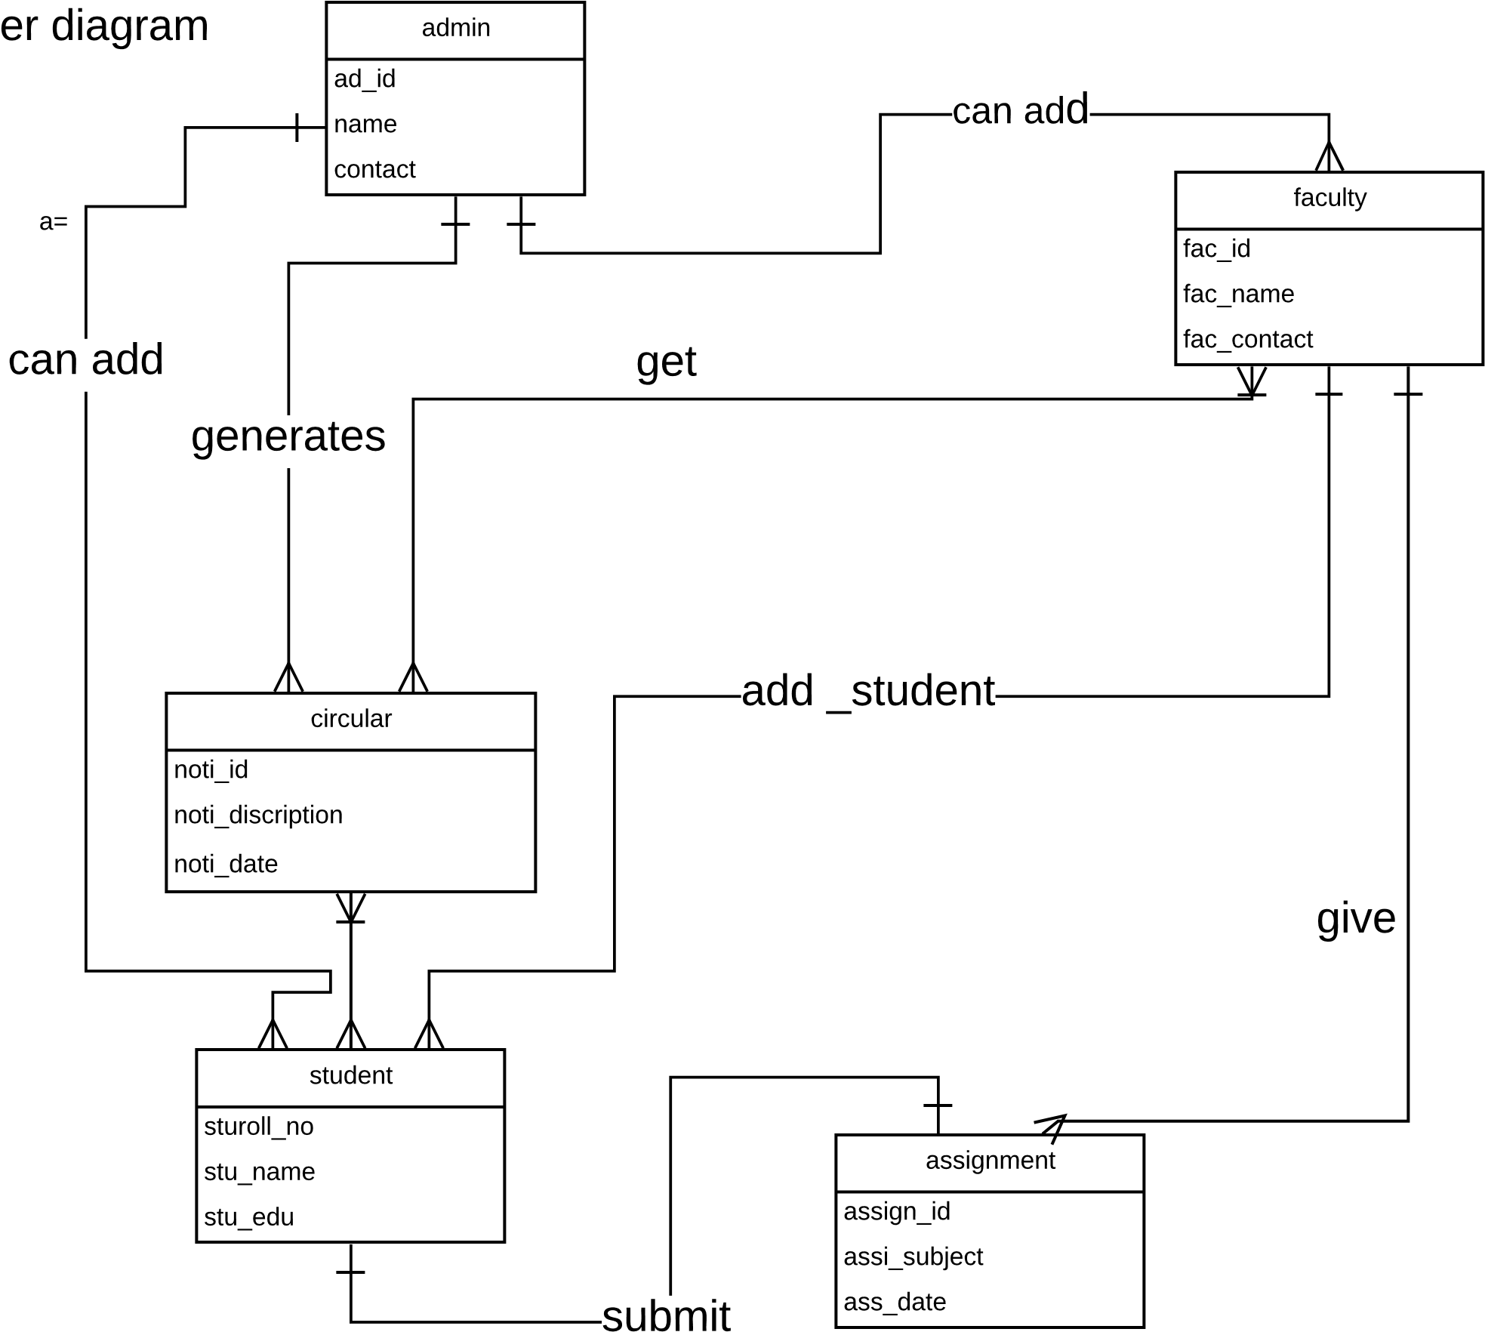

Slide 36
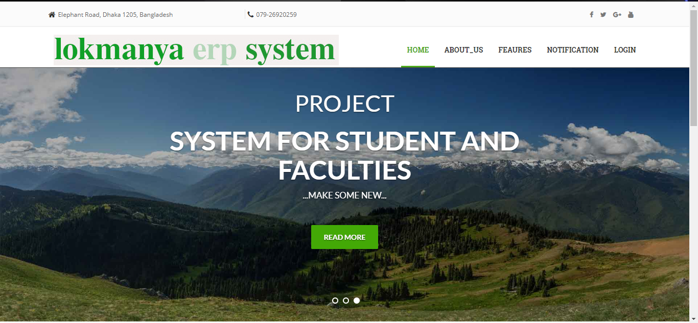

Slide 37
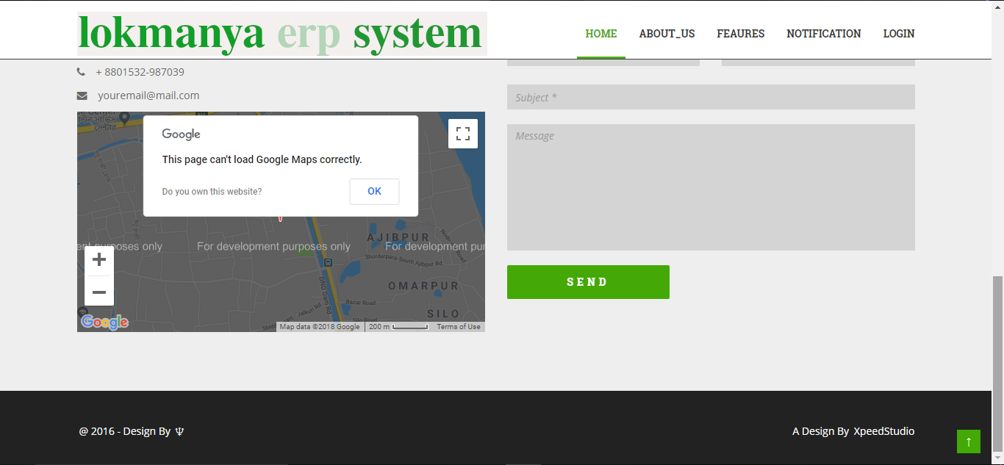

Slide 38
Features enhancement
if we developed this system we can add many more as well as simple things,
some examples are as given
we will add event organizer for students in our system for create their own events and other information, which will be user can add them as personal or public.
User can integrate mail_id to a erp system for better communications.
Faculties can store daily report on this system like presence sheet ,
If we developed this system ,we can add many more things like some notes, reminder,.
We can develop our website more secure as possible and user friendly.
We can update server and connect those to university’s result source page or website and indirect that data to the in our database.

Slide 39
biblography
The information given n this project documentation is borrowed from these following sites.
www.google.com
www.wikipedia.com
www.w3school.com
www.colorlib.com

